Slide 1
K
K E Y T Y P E
SOFTWARE PROJECT LAB-1
Type Like a Pro
Project Mid Presentation

Slide 2
OVERVIEW
Developing a console application to create a typing game where players have to type words as they appear on the screen. The game will generate random words from a provided file and display them on a game board. The player's task is to type the displayed words correctly and as quickly as possible.

Slide 3
PROBLEM STATEMENT
Typing Speed
Skill Development
Typing Accuracy

Slide 4
FEATURE
DISPLAYING WORD RANDOMLY
SCORING SYSTEM FOR CORRECT INPUT
FALL DOWN WORD FOR INCORRECT INPUT
GAME OVER AFTER TOUCHING WALL

Slide 5
CHALLENGES
GENERATING RANDOM NUMBER
READ A LIST OF WORD FROM FILE
DISPLAYING WORD RANDOMLY
FALLING DOWN WORD

Slide 6
PROGRESS
FILE READING
RANDOM
NUMBER
RANDOMLY DISPLAY

Slide 7
FUTURE WORK
FALL DOWN
SCORE
RESUME

Slide 8
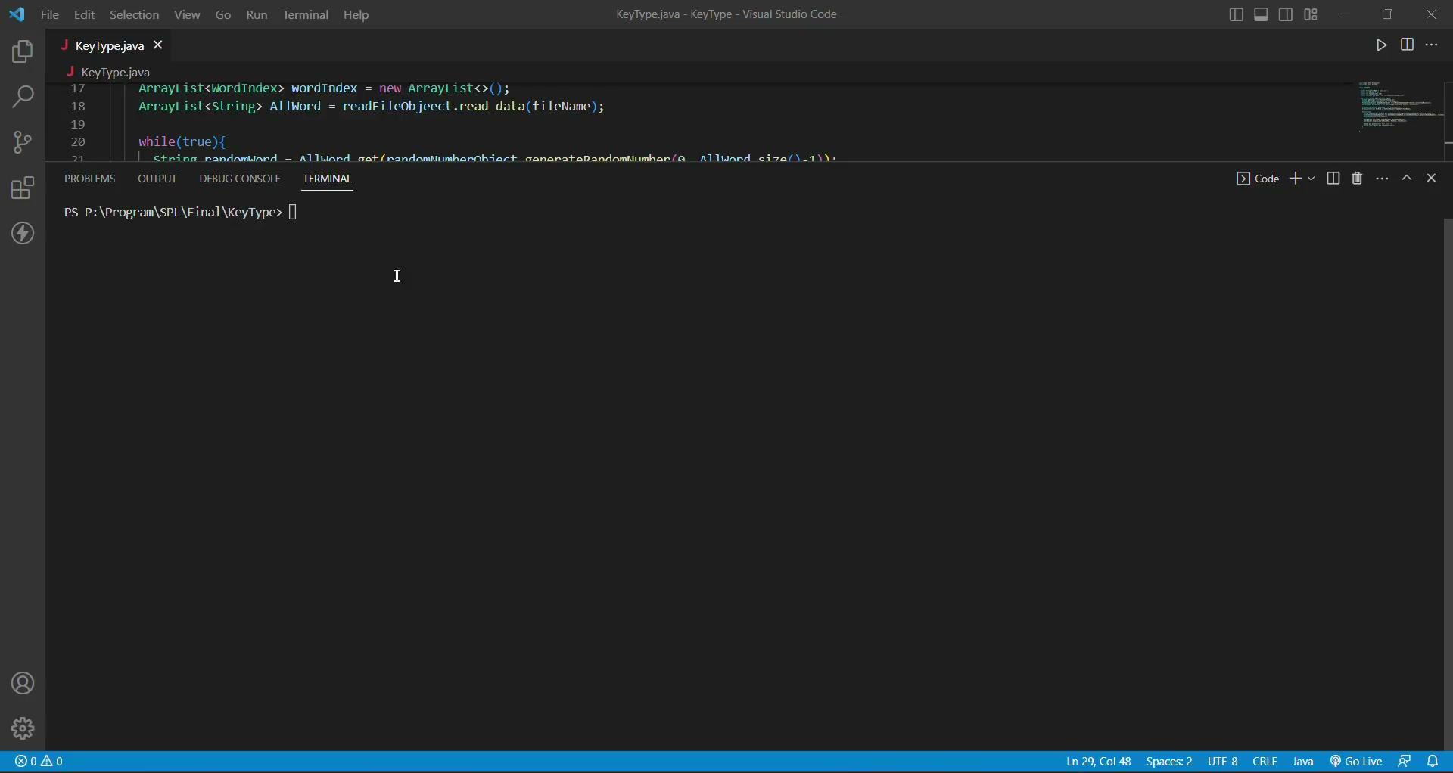
VIDEO PRESENTATION

Slide 9


ANY
QUESTION ?

Slide 10


